Slide 1

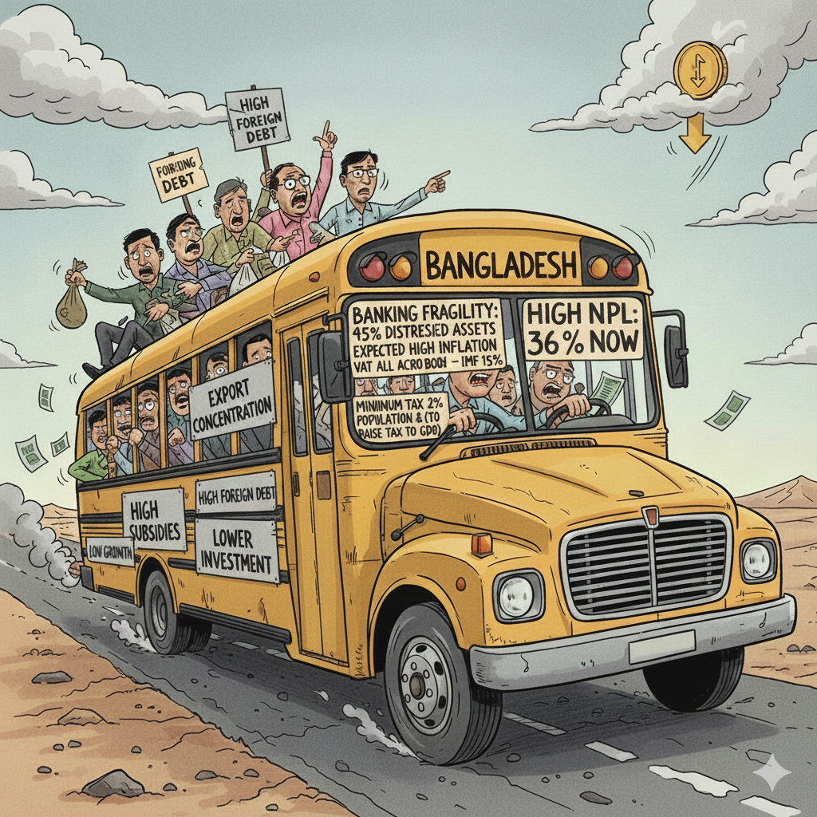
MACRO ECONOMIC REPORT - 2025
Unemployment
MACRO ECONOMIC REPORT - 2025
February Election
AI
The Road to 2026: Reforming Bangladesh’s Economy Amidst Political Transition and Global Instability
www.lioncityadvisory.com

Slide 2

EXECUTIVE SUMMARY
Bangladesh is stabilizing after prolonged macroeconomic distortions. Recovery has begun, but structural risks remain high
Overview
Bangladesh’s economy is showing moderate but resilient recovery in FY2026, supported by higher electricity demand, structural growth in manufacturing and services, and strong remittances. The PMI at 54.0 signals slower momentum, while exports may reach USD 40 billion if markets stabilize despite US tariffs. Imports are projected at USD 68–69 billion, though declining LC activity poses near-term supply risks. The trade deficit narrowed to USD 24.4 billion in FY2025, but the current account returned to deficit early FY2026. The BDT stabilized around 122/USD, though the REER rose, signaling marginal loss of competitiveness, with another 4–5% depreciation expected. Inflation eased to 8.29% (food 7.01%, non-food 9.13%), supported by repo hikes to 10%, while NPLs surged to 35.7% (BDT 6,445 bn), prompting bank mergers. Treasury yields moderated to 10.52–10.89%, and excess liquidity reached BDT 2,196 bn. Structural reforms in banking, capital markets, energy, EVs, and telecom support resilience, but risks remain from currency pressures, inflation, and post-election policy shifts.
+23.6%
35.7%
6.68%
REMITTANCES
(YOY)
NPLS
TAX-GDP
Stability is returning, but reform depth will determine recovery durability.
| PAGE 2

Slide 3
Macro Economic Report 2025
Global Economic Outlook:
Moderate but Uneven Global Growth in 2026: Monetary Easing, U.S.-Led Resilience, and Rising Micro-Level Risks
Global growth in 2026 is expected to remain moderate yet resilient, with GDP expanding slightly above 3%. Easing inflation across major economies is creating space for gradual monetary accommodation.
Markets are increasingly focused on abundant monetary and fiscal support rather than geopolitical risks. The United States remains the primary driver of global growth. Strong household balance sheets, wealth effects, and sustained corporate investment continue to support demand.
Fiscal deficits, early-2026 tax rebates, and policy rates moving toward neutral further underpin growth. However, US growth is clearly K-shaped, with consumption concentrated among middle- and higher-income households.
Corporate capex, particularly in AI and productivity-enhancing technologies, is accelerating.
Micro and structural forces are becoming more influential than headline macro indicators.
AI adoption is uneven but represents a significant long-term boost to productivity and earnings.
Firms integrating AI into operations and decision-making are likely to outperform.
Private credit continues to expand as a flexible alternative to bank lending, without systemic stress so far.
Political developments have generated noise but limited direct market impact.
Most market-relevant policies are already embedded in the system.
Key risk remains a resurgence of inflation driven by fiscal expansion, tight labor markets, and second-round wage effects.
| PAGE 3

Slide 4
Bangladesh's Economic Outlook:
Middle-Income Trap, and the Case for Reconsidering LDC Graduation
Bangladesh’s economic growth has been severely affected over the past five years by successive shocks, including COVID-19–induced global trade contraction, the Russia–Ukraine war, Middle East tensions, tight global monetary conditions, elevated domestic inflation, fiscal austerity, and recent political transition, resulting in growth of just 3.97% in FY2025.
Growth in FY2026 is expected to remain below 4% amid ongoing macroeconomic constraints. While post-election normalization could lift growth above 6% in FY2027, the recovery remains fragile given persistent external and domestic vulnerabilities.
Against this backdrop, Bangladesh faces a growing risk of falling into the middle-income trap due to unresolved structural weaknesses. Proceeding with LDC graduation at this stage may reduce access to concessional financing and preferential market access. A more prudent approach would be to delay graduation until stronger, more durable growth and structural transformation are firmly in place.
| PAGE 4

Slide 5
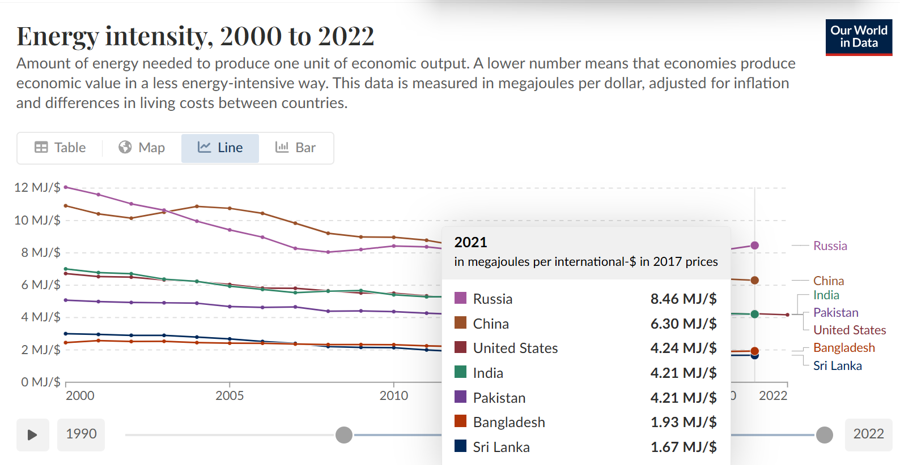
Macro Economic Report 2025
Bangladesh’s Economic Pulse:
Electricity Demand Strengthens as Growth Gradually Recovers
Bangladesh’s electricity demand data indicates a strong rebound in economic activity, with monthly peak demand rising over 6% this year after the disruption-led slowdown in late 2024. The sustained elevation in peak demand suggests a structural recovery, reflecting higher and more stable utilization across factories, commerce, and services.
Looking ahead, supply-side risks are increasing as about 364 MW of capacity is set to retire by 2029, while electricity demand may grow around 10% annually. Without timely capacity replacement and expansion—particularly in renewables—power constraints could emerge and limit medium-term economic growth, underscoring the need for accelerated investment and long-term power-sector planning.
| PAGE 5

Slide 6
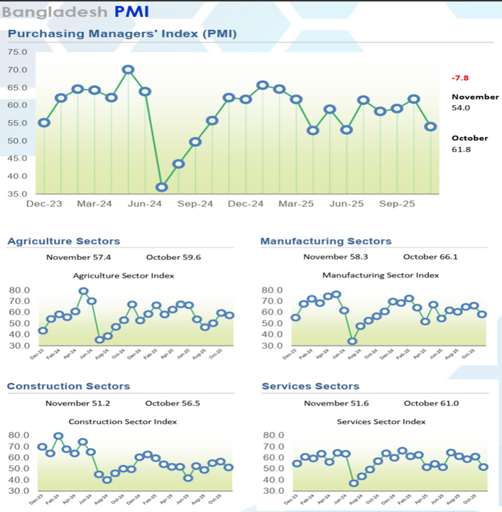
Bangladesh’s Economic Expansion Slows as Sectoral Momentum Softens Amid Ongoing Uncertainty
Bangladesh’s November PMI eased to 54.0, indicating slower but still expansionary growth as momentum softened across agriculture, manufacturing, construction, and services. Weaker new orders, faster backlog contraction, and election-related investment delays weighed on activity, with PMI expected to remain subdued through March 2025.
Services showed the sharpest cooling, while manufacturing continued to expand despite easing pipeline pressures. Overall, the PMI signals loss of momentum rather than contraction, with improved future expectations pointing to potential stabilization once political uncertainty recedes.
CPA Per Campaign
| PAGE 6

Slide 7
Macro Economic Report 2025
Following the political transition, Bangladesh’s exports saw a brief stabilization, growing 7.7% YoY in FY2025, with monthly earnings peaking at USD 4.7–4.8 billion during May–July. Momentum later softened as US tariff actions under the Trump administration took effect, pulling monthly exports down to USD 3.8–3.9 billion by October–November, with exporters absorbing part of the cost to stay competitive.
In the first five months of FY2026, exports reached USD 20 billion, reflecting only modest growth as the tariff-driven boost faded. Full-year exports could approach USD 40 billion.
Sustained export growth will require lowering cost pressures and diversifying beyond RMG, with greater emphasis on MMF apparel, footwear, agro-processing, electronics, and digital services as temporary tariff advantages diminish.
Bangladesh’s Export Rebound:
Navigating Tariff Pressures and Building Sustainable Diversification
| PAGE 7

Slide 8
In FY2025, Bangladesh’s import growth remained subdued at 2.44%, reflecting weaker capital machinery imports and softer global commodity prices.
During July–October, imports rose 4.52% YoY, and if this trend continues, full-year imports are likely to reach USD 69-70 billion, driven mainly by raw materials, capital goods, and essential consumer items.
However, the continued decline in LC openings poses near-term risks. With Ramadan and national elections approaching, weak LC activity could lead to supply constraints and price pressures unless imports recover before February to rebuild inventories and stabilize production.
Import starts to stabilize with Relaxed Controls
| PAGE 8

Slide 9
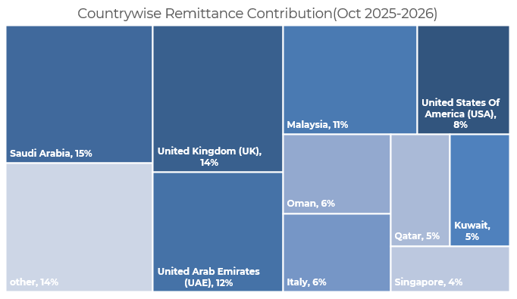
Remittance:
The Lifeline of Bangladesh’s Economy
Macro Economic Report 2025
In FY2025, remittance inflows reached $30.32 billion, marking a robust 23.6% year-on-year increase (over $7 billion higher than the previous year). The United States, Saudi Arabia, and the United Arab Emirates & United Kingdom remained the top sources of remittance.
During the first five months of FY2026, remittance inflows remained strong, rising 17.1% year-on-year, and could reach around USD 35 billion by year-end if the trend continues, providing critical support to the economy.
BMET data show a sharp increase in overseas employment, with 309,945 workers deployed during July–September FY26, up from 247,619 in April–June FY25. Saudi Arabia accounted for about 61.9% of total placements in the quarter, reflecting robust demand.
The sustained rise in outbound labor indicates a continued recovery in international recruitment, underpinning remittance growth and external sector stability. In the short term, fewer new migrants will have limited effect, but in the medium to long term , the growing use of AI and automation in major labor-importing countries pose challenges for Bangladesh’s overseas employment prospects.
| PAGE 9

Slide 10
External Sector Pressures Re-emerge:
Trade and Current Account Deficits Widen in Early FY2026
  In FY2025, Bangladesh’s trade deficit narrowed 5.6% year-on-year to USD 24.4 billion, supported by restrained import growth and stronger exports.
  In the first four months of FY2026, the trade deficit stood at USD 7.4 billion, as imports continued to exceed export earnings.
  During July–October FY2026, the current account balance slipped back into a USD 0.75 billion deficit after briefly turning positive in FY2025, highlighting renewed external pressures.
  Although the deficit remains manageable by historical standards, it underscores ongoing vulnerability to trade dynamics and import recovery. Achieving a current account surplus by end-FY2026 will depend on sustained export growth, strong remittance inflows, and a gradual—not abrupt—rebound in imports.
| PAGE 10

Slide 11
Macro Economic Report 2025
Foreign Direct
Investment (FDI)
Hits a Plateau
  Net foreign direct investment (FDI) in Bangladesh increased by 13.3% in FY2025, signaling a modest recovery in investor sentiment. Reinvested earnings and Intra-company loans accounted for 68% of total FDI inflows, highlighting a continued reliance on existing investors rather than new capital inflows. However, this share declined slightly from last year as dividend repatriation challenges eased, enabling smoother fund transfers for foreign companies.
  Despite the year-on-year increase, the overall investment environment remains challenging. Persistent concerns over election-related uncertainty, macroeconomic instability—including currency devaluation—and Bangladesh’s poor ease of doing business ranking have weighed on investor confidence. Furthermore, recent credit rating downgrades have added to the cautious stance of global investors.
  With an FDI-to-GDP ratio of just 0.3%, the lowest in the region, Bangladesh still struggles to attract large-scale foreign investments. However, with Dr. Muhammad Yunus leading the interim government, there is renewed optimism that improved governance, transparency, and policy consistency could help restore investor confidence and stimulate greater FDI inflows in the coming years.
| PAGE 11

Slide 12
Foreign Exchange Reserves Rebound,
but Debt Servicing Risks Persist
Bangladesh’s financial account turned negative in 2023 for the first time in 13 years amid heightened economic instability, but rebounded to a USD 3.98 billion surplus in FY2025.
In the first three months of FY2026, the financial account recorded a further USD 2.17 billion surplus, largely reflecting improved settlement of banks’ external transactions and government measures to rebuild foreign exchange reserves.
The durability of this recovery beyond the February 2026 election will depend on policy continuity and sustained investor and market confidence.
T
Bangladesh’s foreign exchange reserves recovered to USD 26.7 billion in FY2025 and further increased to USD 28.11 billion by December 2025, lifting import cover to over five months after two years of decline.
Reserves had fallen sharply from USD 46.4 billion in FY2021 following the 2022 global commodity price shock and higher import costs, including the impact of US tariffs.
The recent rebound has been supported by DFI inflows and policy backing for the new government led by Dr. Yunus, though rising external debt servicing obligations remain a key risk to reserve sustainability.
| PAGE 12

Slide 13
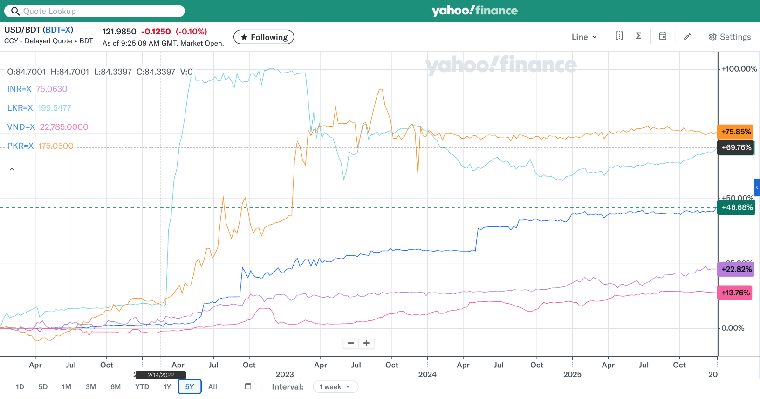
Macro Economic Report 2025
Currency Stabilizes after Years
Over the past four years, the USD has appreciated 44% against the BDT, reflecting sharp depreciation driven by earlier policy missteps, particularly the delayed adjustment during 2012–2021. More recently, the currency has stabilized amid reserve rebuilding, a more flexible exchange-rate regime, current account improvement, and tight monetary policy.
As of December 2025, the exchange rate stands at BDT 122.32 per USD. However, the REER increased to 106.55 in October 2025, signaling a marginal loss of competitiveness due to price differentials. Looking ahead, the BDT is expected to depreciate by a further 4% next year to 128 against USD.
$ 300
CTR Per Campaign
CPC Per Campaign
$ 625
CPA Per Campaign
| PAGE 13

Slide 14
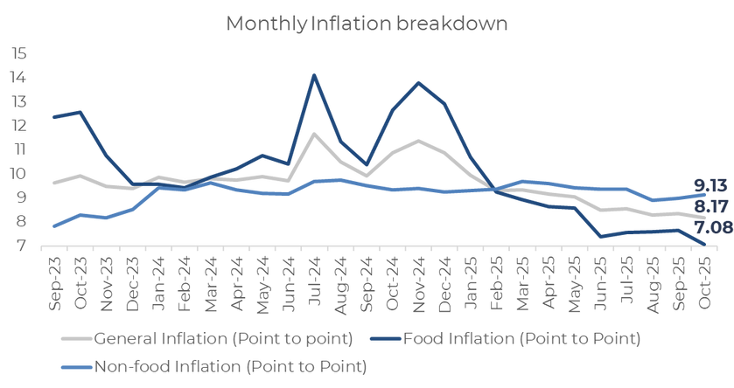
Inflation Started to cool down
Bangladesh’s inflation peaked at 11.66% in July 2024 and remained elevated at 11.38% in November 2024, before easing to 8.29% in November 2025 as food prices moderated. Currently, food inflation stands at 7.01% and non-food inflation at 9.13%, according to BBS. Improved data transparency under the current government has strengthened credibility, though inflation remains sticky due to past BDT depreciation and reduced power-sector subsidies, despite a sharp fall in global commodity prices since 2022.
To contain inflation, Bangladesh Bank has raised the repo rate to 10% through three hikes, tightening monetary conditions.
Looking ahead, inflation is expected to gradually decline toward around 7% in early 2026 and closer to 6% thereafter, assuming exchange-rate stability and better measurement. However, IMF-flagged risks remain, as a potential post-election VAT increase on the power sector to 15% could keep non-food inflation elevated.
CPC Per Campaign
$ 625
CPA Per Campaign
| PAGE 14

Slide 15
Macro Economic Report 2025
T
Broad Money growth is driven by Net Foreign Asset Growth
| PAGE 15

Slide 16
Delayed Response to Swift Action:
Bangladesh Bank's Policy Shift to Tackle Inflation
  US inflation surged after the Russia-Ukraine war due to supply chain disruptions. In response, the Federal Reserve swiftly raised policy rates from 0.25% to 5.5%, curbing peak inflation of 8.7% to 2.9%, before later easing rates to 4.25%. However, October inflation data were not published due to the US government shutdown, adding temporary uncertainty to near-term inflation assessment, while renewed trade frictions and tariff-related supply disruptions continue to pose upside risks..
  In contrast, Bangladesh Bank delayed its response, raising policy rates only a year after the US, while maintaining an interest rate cap that slowed the impact of monetary policy. As a result, inflation remained persistently high. However, with the new governor taking charge, the policy rate was increased by 150 basis points within six months, and rates are now market-driven — marking the first time in five years that inflation has fallen below the policy rate.
$ 300
CTR Per Campaign
CPC Per Campaign
| PAGE 16

Slide 17
Macro Economic Report 2025
  The Standing Lending Facility (SLF) and Standing Deposit Facility (SDF) are key monetary policy tools utilized by the Bangladesh Bank. The SLF allows the central bank to provide overnight credit to eligible banks during liquidity shortages, while the SDF enables banks to deposit excess liquidity with the central bank.
  Recently, the rates for SLF has been raised to 11.5% and SDF has been raised to 8.5% to control money supply and curb inflation. However, as there is indication of low inflation central bank reduce SDF to 8%.
  We are expecting rate cut after election.
Bangladesh Bank Hikes SLF and SDF Rates to Tame Inflation
$ 300
CTR Per Campaign
| PAGE 17

Slide 18
Treasury Yield started to fall due to high liquidity in the market
  Bangladesh’s Treasury bill yields have eased from the decade-highs above 12.5% earlier this year to around 10.52%–10.89%, reflecting improved liquidity after aggressive monetary tightening by Bangladesh Bank.
  Yields have moderated across the curve as the central bank absorbed excess taka through foreign exchange interventions and inflation pressures eased. The decline also indicates rising market confidence supported by clearer policy guidance and reduced uncertainty, even though financial conditions remain tight.
  Looking ahead, a further 200 bps cut across all maturities is expected by the end of next year.
T
| PAGE 18

Slide 19
Macro Economic Report 2025
  The Weighted Average Lending Rate continues to rise after the removal of the interest rate cap, currently standing at 12.14%, while the Weighted Average Deposit Rate has increased to 6.40%, resulting in a spread of 5.8%.
  Deposit rates are expected to stabilize now with lending rates now exceeding 13% in the banking sector and 16% in the NBFI sector.
  The sustained rising cost of borrowing is driving up the cost of doing business, leaving companies with low EBITDA margins struggling to service their debts.
Rising Rates Strain Businesses
T
| PAGE 19

Slide 20
Bangladesh’s NPL Crisis:
Highest in South Asia and the Path to
  As of September 2025, Bangladesh’s non-performing loans (NPLs surged to BDT 6,445 billion, representing 35.7% of total loans—the highest in South Asia. The sharp rise followed Bangladesh Bank’s April 2025 move to classify loans as non-performing after three months overdue, instead of six, aligning with Basel III and IFRS 9 standards. The disclosure, emerging under the interim government after the end of Sheikh Hasina’s 15-year rule, revealed years of window dressing that had masked true default levels.
  The situation is compounded by a provision shortfall of BDT 3,886 billion, posing a serious threat to financial stability.
  In response, Bangladesh Bank has begun merging weak banks as part of its resolution and restructuring efforts to contain systemic risk.
| PAGE 20

Slide 21
Macro Economic Report 2025
Liquidity started to ease due to low private sector credit growth and Dollar Buying by BB
Excess liquidity in Bangladesh’s banking system has risen to BDT 2,196 billion, driven by slower private-sector credit growth and ongoing dollar purchases by Bangladesh Bank to support the forex market.
As liquidity conditions ease, the call money rate, which had peaked at 10.5%, has fallen below double digits to 9.96%, signaling reduced short-term funding pressure.
T
| PAGE 21

Slide 22
Private Sector Credit Growth Slows Amid High Rates and Economic Uncertainty
  Private sector credit growth slowed to 6.23% in October 2025 lowest in last 22 years due to investment uncertainty following the political changeover, persistent inflation, and rising borrowing costs. The Bangladesh Bank raised the policy rate to 10% on October 22, the 11th hike since May 2022, aiming to curb inflation but discouraging investment and restricting money supply.
  High interest rates, a liquidity crisis, weak law-and-order conditions, and persistent inflation ( well above 8 % in till date)are suppressing credit demand and dampening the investment climate. These factors have slowed economic growth to 3.97% in FY25.
  Prolonged contractionary monetary policies may reduce productive capacity, hurt small and medium enterprises, and increase non-performing loans. The government’s net borrowing from the banking system rose by Tk 5,764 crore in the FY 2024-25, amid falling tax revenues and rising foreign debt servicing costs, this is raising concerns over crowding out private credit. However, the uncertain political environment remains the biggest obstacle to sustained economic stability.
T
| PAGE 22
PAGE 05

Slide 23
Macro Economic Report 2025
Bangladesh Grapples with Revenue Collection Challenges question GDP Growth
  Bangladesh's tax-to-GDP ratio fell to 6.68% in FY25, among the lowest in South Asia, with only 37 lakh out of 1.2 crore TIN holders filing taxes. Inefficiencies, corruption, and lack of public trust in the tax system, coupled with systemic flaws in the NBR, have hindered revenue growth.
  IMF's recommendation to raise Bangladesh's revenue target to 0.5% of GDP, tied to a $4.70 billion loan, underscores the urgency for the country to elevate its revenue-GDP ratio to 10% in FY25
  To boost tax revenue, simplifying tax filing processes, making them mobile-friendly, and incentivizing digital payments can encourage compliance, particularly among the informal sector. Expanding services through upazila offices and increasing transparency can further engage taxpayers.
T
| PAGE 23
PAGE 05

Slide 24
Foreign Exchange Reserve of Commercial Banks
  Liquidity in commercial banks has improved significantly in recent months. However, Bangladesh Bank continues to mop up excess dollar liquidity from the market to stabilize the exchange rate and strengthen the Balance of Payments (BoP) position.
T
| PAGE 24
PAGE 05

Slide 25
Macro Economic Report 2025
External Debt Keep rising
Particulars in USD BN | FY 2021 | FY 2022 | FY 2023 | FY 2024 | FY 2025
Total Debt | 167 | 194 | 194 | 186 | 193
Internal Debt | 85 | 98 | 96 | 82 | 80
External Debt | 82 | 95 | 98 | 103.79 | 113.2
Public | 62.9 | 69.5 | 75.85 | 83.22 | 93.42
Private | 18.72 | 25.95 | 22.26 | 20.57 | 19.77
Public sector External Debt % GDP | 15% | 15% | 16.7% | 18.5% | 20.2%
Total External Debt % GDP | 19% | 22.7% | 23% | 23.1% | 24.5%
Total Debt % of GDP | 32.41% | 33.79% | 36.34% | 36.30% | 41.75%
  Bangladesh’s reported Debt-to-GDP ratio for FY 2025 stands at 41.75%.
  As of 31 March 2025, the outstanding stock of government guarantees stood at $9.8 billion, adding further strain to the fiscal outlook.
  Despite these pressures, the debt remains below critical thresholds—Debt-to-GDP at 70% and foreign debt at 50% of GDP. Prudent fiscal management and efficient resource utilization are crucial to avoid further financial distress.
| PAGE 25
PAGE 05

Slide 26
Bangladesh Credit Rating
MOODY’S
S&P
NOV 2024
B2
NEGATIVE
JUL 2024
B+
STABLE
MAY 2023
B1
STABLE
JUL 2023
BB-
NEGATIVE
DEC 2022
Ba3
UNDER REVIEW
APR 2010
BB-
STABLE
APR 2012
Ba3
STABLE
  Moody's downgraded Bangladesh's sovereign rating from B1 to B2 with a negative outlook, which also impacted six banks, including BRAC Bank, City Bank, and Dutch-Bangla Bank. Moody's Ratings has downgraded Bangladesh's banking system outlook from "stable" to "negative after rescheduling facility.
  Whereas S&P downgraded from BB- to B+. The downgrade could still impact investor confidence, foreign fund pricing, and overall trust in the banking system.
  The rating emphasizes structural weaknesses such as liquidity constraints, politically influenced loan defaults, and poor asset quality under the previous regime.
  Moody’s has failed to account for the recent reforms by Bangladesh Bank, including steps to improve asset quality and align regulatory practices with international standards.
| PAGE 26
PAGE 05

Slide 27
Macro Economic Report 2025
  Bangladesh is grappling with both a current account deficit and a budget deficit, commonly referred to as a twin deficit.
  Subsidy expenditures in FY25 are projected to rise to Tk 1,12,000 crore, with the corrupted power sector receiving Tk 42,000 crore due to higher energy costs and undue and unplanned capacity payments, while agricultural subsidies are set to increase to Tk 25,000 crore. Export incentives will decline as the country transitions out of LDC status.
  Social safety net allocations will remain at 2.5% of GDP, with a slight rise in beneficiaries but unchanged individual allowances for most groups.
  The government plans to reform subsidy and social safety net distribution through mobile financial service (MFS) accounts to improve efficiency and reduce corruption.
Bangladesh Faces Twin Deficits Amid Rising Subsidy Expenditures
T
| PAGE 27
PAGE 05

Slide 28
Labor Force and Participation Dynamics
  In 2024, Bangladesh’s labor force contracted beyond what participation rates alone explain, reflecting demographic and structural pressures—especially youth discouragement and delayed entry—leading to rising labor underutilization and employment stress showing up as labor force exit rather than unemployment.
Employment Growth and Demographic Pressures
  Employment growth in Bangladesh has fallen behind population growth, turning negative in 2024 despite population growth of about 1.2%. This widening gap signals weak job creation, rising labor underutilization, and a growing dependency burden, indicating that recent economic growth has been less employment-intensive.
Reassessing Unemployment: Beyond Headline Rates
  A broader reassessment of Bangladesh’s labor market suggests effective unemployment may be far higher than official figures, with an implied rate near 19% in 2024 once discouraged, inactive, and NEET individuals are considered.
  Youth labor market stress is structural: the youth labor force has shrunk sharply since 2022, while unemployment remains high and disengagement has risen.
  Around 27% of youth aged 15–29 are NEET, nearly 90% of them women, highlighting deep gender barriers to labor force participation.
  These pressures are compounded by demographic dependency, as a large non-working population relies on a narrow and slowing employment base. Policy debates on unemployment allowances reflect rising stress but raise fiscal sustainability concerns given limited revenues and informality. Evidence points toward employment-intensive growth, skills alignment, female participation, and AI-ready training as more sustainable solutions than passive transfers.
| PAGE 28
PAGE 05

Slide 29
Macro Economic Report 2025
4 Material Vulnerability
Challenges For The Newly Elected Government In 2026
  Banking Fragility
  Bangladesh’s banking sector has grown more fragile since 2024 as asset quality deteriorated sharply. The gross NPL ratio rose from 8–10% in 2021–23 to over 20% by end-2024 and 35.7% by Sep 2025, weakening profitability, capital, and credit growth—especially in state-owned and weaker Islamic banks. Inadequate provisioning and slow loan resolution risk further balance-sheet stress unless decisive asset clean-up, recapitalization with governance reform, and faster recovery measures are implemented.
  Export Concentration
  Bangladesh’s exports remain highly concentrated, with RMG accounting for over 84% of merchandise exports and heavy reliance on the EU and US markets. This lack of diversification increases vulnerability to global demand shocks, trade policy changes, and supply-chain disruptions, limiting shock absorption and value-chain upgrading.
  Fiscal Weakness
  Bangladesh’s fiscal space is constrained by a low tax-to-GDP ratio of around 8%, restricting the government’s ability to finance development and counter economic shocks. Fiscal deficits hover near 4% of GDP, and without reforms to broaden the tax base and improve compliance, fiscal capacity will remain weak.
  If the new government increases VAT and Turnover tax, then inflation may go up.
  Foreign Exchange (FX) Liquidity
  Foreign exchange reserves stood at about USD 28 billion in 2025, covering roughly five months of imports and offering a limited buffer against external shocks. Tight FX liquidity heightens sensitivity to fluctuations in exports, remittances, and commodity prices, underscoring the need for reserve accumulation through diversification and stable inflows.
| PAGE 29
PAGE 05

Slide 30
Banking Sector Reform and Resolution Framework: Key Developments
The government plans to re-privatize the bank within 2–3 years, with further bank amalgamations expected.
Bangladesh Bank has also issued Five LoIs for private credit bureaus and is considering digital bank licenses to deepen financial intermediation.
Rescheduling and one-time exit facilities have been expanded to manage stress.
Overall, the reforms enhance financial stability, contain systemic risk, and restore confidence, though short-term liquidity support may weigh on public finances.
We expect further bank amalgamations in the coming years, and it is critical that the ongoing reform momentum is sustained to ensure long-term financial stability and restore confidence in the banking sector.
The Bank Resolution Ordinance, 2025 appoints Bangladesh Bank as the sole Resolution Authority, enabling swift intervention in failing banks without judicial delays.
It introduces tools such as bridge banks, asset–liability transfers, and bail-in mechanisms, limiting the need for direct fiscal bailouts.
Directors and major shareholders can be held personally liable for losses from fraud or misgovernance, strengthening accountability.
Under this framework, five distressed banks were merged to form Sommilito Islami Bank PLC.
The new bank has the largest paid-up capital in the sector (Tk 35,000 crore) and an extensive branch network, ensuring depositor continuity.
Depositors are receiving payouts up to Tk 2 lakh initially, with remaining balances repaid gradually under a defined roadmap.
The government plans to re-privatize the bank within 2–3 years, with further bank amalgamations expected.
Bangladesh Bank has also issued Five LoIs for private credit bureaus and is considering digital bank licenses to deepen financial intermediation. Rescheduling and one-time exit facilities have been expanded to manage stress.
| PAGE 30
PAGE 05

Slide 31
Macro Economic Report 2025
BSEC 2025 Reforms: Strengthening Stability but Challenging Market Growth
In 2025, BSEC introduced a broad reform agenda covering mutual funds, IPOs, and margin financing to restore confidence, improve governance, and reduce systemic risk in Bangladesh’s capital market.
The Mutual Fund Rules banned new closed-end funds, enforced minimum capital and fund-size requirements, capped fees, tightened investment concentration limits, mandated timely dividends, and strengthened governance and inspection powers. These measures aim to protect retail investors, reduce volatility, and eliminate weak market participants.
The draft IPO Rules seek to improve pricing efficiency and market credibility by mandating multi-model valuation, raising minimum paid-up capital, requiring positive operating cash flow, increasing institutional and mutual fund participation, and shortening approval timelines. However, higher capital and compliance thresholds may delay IPO entry for mid-sized firms, constraining short-term equity issuance.
A critical weakness is the absence of a mandatory debt repayment requirement from IPO proceeds, allowing leveraged firms to list without balance-sheet repair, effectively shifting financial risk to public investors.
The Margin Rules significantly tighten leverage by capping margin financing at 1:1, introducing automatic market-wide tightening based on P/E levels, restricting financing to fundamentally sound stocks, and enforcing strict maintenance and forced-sale rules. While these steps materially reduce speculative excess and crash risk, they may also suppress liquidity and price discovery in the short term, particularly in a relatively shallow market.
Overall, the reforms are directionally strong and enhance long-term stability, governance, and investor protection. However, the package leans heavily toward restriction rather than market development. Phased implementation, greater flexibility for mid-sized firms, product diversity, and stronger balance-sheet discipline
| PAGE 31
PAGE 05

Slide 32
Green Energy Transition: Renewable Energy and Draft Electric Vehicle Policies 2025
Renewable Energy Merchant Power Policy 2025
The 2025 policy shifts Bangladesh’s renewable energy framework from state-backed contracts to a merchant model, allowing producers to sell electricity directly to large industrial consumers, including EPZs and industrial parks.
Eligible projects range from 5 MW to 140 MW and can be developed by local, foreign, or PPP investors, with state-owned entities participating only as partners.
Developers gain open grid access with regulated wheeling charges and loss factors, and can earn additional revenue through Renewable Energy Certificates (RECs).
Incentives include tax holidays, duty exemptions, green finance access, and use of tea-estate land for projects.
The policy aims to attract private investment, reduce fiscal burden from subsidies, support decarbonization, and enhance competitiveness and external sector resilience, though short-term risks remain from grid limitations and tariff uncertainty.
Electric Vehicle Industry Development (Draft) Policy 2025:
The 2025 draft policy introduces wide-ranging incentives to promote electric vehicle (EV) adoption and local manufacturing.
EV registration fees are halved compared to ICE vehicles, with advance income-tax exemptions until 2030 to lower acquisition costs.
Tax rates on Completely Built Unit (CBU) electric cars are reduced to 37%, and for buses and trucks to 31%, while Completely Knocked Down (CKD) EVs face 15.25% tax with 0% VAT until 2035.
Local EV manufacturing benefits from 1% customs duty on raw materials, full VAT and income-tax exemption until 2040, and reduced-duty HS codes for lithium-ion batteries. EV charging station operators receive a 10-year income-tax holiday, with strong incentives for private investment.
Public and semi-public entities are mandated to procure at least 30% EVs by 2030.
The policy is expected to accelerate EV adoption, reduce fuel imports, attract private investment, and support green industrialization, though short-term revenue foregone is a fiscal consideration.
| PAGE 32
PAGE 05

Slide 33
Macro Economic Report 2025
Bangladesh Telecom Policy 2025: Simplification, Modernization, and Future-Ready Licensing
The 2025 policy modernizes Bangladesh’s telecom framework by replacing the outdated ILDTS-2010 with a technology-neutral, simplified licensing structure.
Complex, multi-layer licenses are consolidated into a few core network and service layers to streamline operations.
Infrastructure sharing and unified traffic routing are emphasized, while domestic peering and traffic localization aim to reduce international traffic leakage.
Licensing now accommodates emerging technologies including 5G/6G, satellite, IoT, cloud, and digital platforms.
The policy introduces clear ownership rules, migration timelines, and enforcement mechanisms, with a structured transition planned through 2027.
Other Major Developments:
Labor law update
Constitution amendment and provision for public referendum
| PAGE 33
PAGE 05

Slide 34
Asset Class Return In Bangladesh in 2025
Gold Return
64.86%
Bond Return
10 years-22%
15 years-18%
US Dollar return
1.93%
Real Estate
Return
Flat to negatives
Share Return
DSEX: -6.73%
(cap loss only)
T
Expected Asset Class Return In Bangladesh in 2026
  Bond to provide another ~15-20% total Return
  Shares to provide ~12%-15% Return
  Gold to provide ~10% Return
  Dollar to provide ~4%
  Real Estate might remain flat
| PAGE 34

Slide 35
Disclaimer
This Lion City Advisory Limited (LCAL) on the basis of the public information available in the market, internally developed data and other sources believed to be reliable. Whilst all reasonable care has been taken to ensure that the facts and information stated in the Documents are accurate as on the date mentioned herein. Neither LCAL nor any of its directors, shareholders, member of the management or employee in the research team or employee represents or warrants expressly or impliedly that the information or data of the sources used in the document are genuine, accurate, complete, authentic, and correct. Moreover, none of the directors, shareholders, management, or employee in the research team or employee is responsible for the completeness, authenticity and correctness of the publicly available sources to prepare the Document. It does not solicit any action based on the materials contained herein and should not be construed as an offer or solicitation to BUY or SELL or SUBSCRIBE to any security. If any person takes any action relying on this Document, shall be responsible solely by himself/herself/themselves for the consequences thereof any claim or demand for such consequences shall be rejected outright by LCAL or by any court of law.
Data Source: Bangladesh Bank, Dhaka Stock Exchange, Bangladesh Securities and Exchange Commission, Ministry of Finance, ERD, EPB, BPDB, BBS, World Bank, Company’s Annual Report, The Daily Star, The New Age, The Financial Express and The Business Standard.
Macro Analyst
Md. Abdullah Al Faisal | Director, Lion City Advisory Limited | faisal@lioncityadvisory.com
Kashfia Binte Hassan | Analyst (ECM-DCM), Lion City Advisory Limited | safa@lioncityadvisory.com
Tahmina Jahan | Analyst, Lion City Advisory Limited | tahmina.lioncity@outlook.com
Md. Sakib Ahammod | Analyst, Lion City Advisory Limited | sakib.lioncity@outlook.com

